Slide 1
Performing Conditional Analysis
11.09.2020

Slide 2
Check to See Whether a Simple Condition Is Met
A condition is a value or expression that returns TRUE or FALSE. Based on the value of the condition, a formula can branch into two separate calculations. That is, when the condition returns TRUE, one value or expression is evaluated while the other is ignored. A FALSE condition reverses the flow of the formula, and the first value or expression is ignored and the other evaluated.

Slide 3
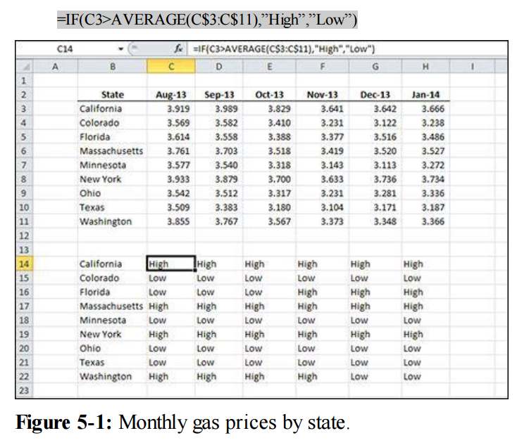
Figure displays a list of states and six monthly gas prices. For each price, say that you want to determine whether that state’s price in that month is above or below average for all the states for the same month. For higher-than-average prices, you report “High,” and for lower than average, “Low”. A grid below the data is used to report the results.

Slide 4
How it works
The IF function is the most basic conditional analysis function in Excel.
It has three arguments: the condition; what to do if the condition is true; and what to do if the condition is false.
The condition argument in this example is C3>AVERAGE(C$3:C$11). Condition arguments must be structured to return TRUE or FALSE, and that usually means that there is a comparison operation (like an equal sign or greater-than sign) or another worksheet function that returns TRUE or FALSE (such as ISERR or ISBLANK). In this example, the condition has a greater-than sign and compares the value in C3 to the average of all the values in C3:C11.

Slide 5
Checking for Multiple Conditions
Simple conditions like the one shown in the previous Formula can be strung together. This is known as nesting functions. The value_if_true and arguments can contain simple condition value_if_false depends on their own. This allows you test more than one condition where subsequent conditions are dependent on the first one.

Slide 6
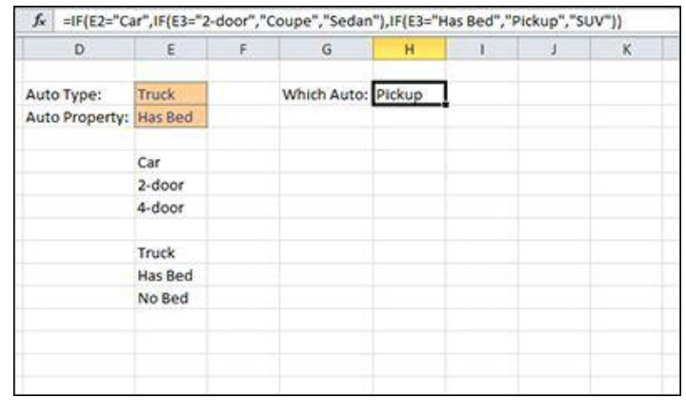
Figure shows a spreadsheet with two user input fields for the type of automobile and a property of that automobile type. The properties are listed in two ranges below the user input fields. For this example, when the user selects the type and property, you want a formula to report whether the user has identified a coupe, a sedan, a pickup, or an SUV, as follows: =IF(E2="Car",IF(E3="2-door","Coupe","Sedan"),IF(E3="Has Bed","Pickup","SUV"))

Slide 7
How it works
With some conditional analysis, the result of the first condition causes the second condition to change. In this case, if the first condition is Car, the second condition is 2- door or 4-door. But if the first condition is Truck, the second condition changes to either Has Bed or No Bed. The data validation in cell E3 in Figure changes to allow only the appropriate choices based on the first condition.
In Figure user has selected “Truck”. The first IF returns FALSE because E2 doesn’t equal “Car” and the FALSE argument is evaluated. In that argument, E3 is seen to be equal to “Has Bed” and the TRUE condition (“Pickup”) is returned. If the user had selected “No Bed”, the FALSE condition (“SUV”) would have been the result

Slide 8
Using Lookup Formulas
Finding data in a list or table is central to many Excel formulas. Excel provides several functions to assist in looking up data vertically, horizontally, from left to right, and from right to left. By nesting some of these functions, you can write a formula that looks up the correct data even after the layout of your table changes.

Slide 9
Looking Up an Exact Value Based on a Left Lookup Column
Many tables are arranged so that the key piece of data, the data that makes a certain row unique, is in the far-left column. Although Excel has many lookup functions, VLOOKUP was designed for just that situation

Slide 10
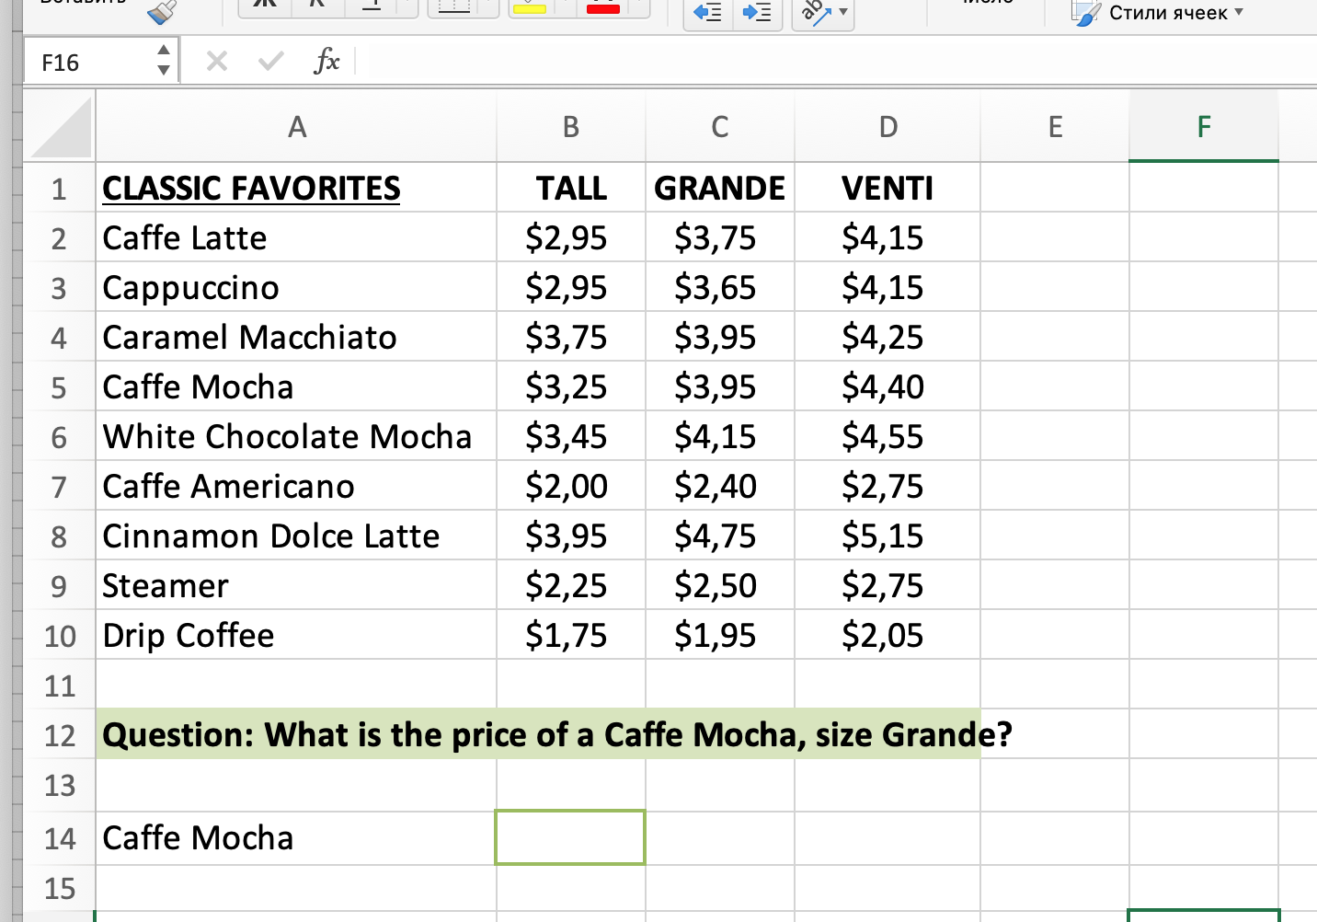
task1

Slide 11
Excel Definiation:
=VLOOKUP(lookup_value, table_array, col_index_num, [range_lookup])
Simple Definiation:
=VLOOKUP(value to look for,
range to look in,
column number of value to return,
approximate or exact match[TRUE/FALSE])

Slide 12
When using “False” or “0” it will return an exact match. Excel will start at the top of the list and work down, if the lookup value exists in the list it will return a value, but if it does not, it will return #N/A. This seems easy to understand, if it’s there, it returns a value, if it’s not, it won’t. Simple.
However, what happens if we use “True” or “1” as the last statement? We can receive all sorts of strange results. If we do not know what VLOOKUP is doing, it can result in some significant errors in our workbooks.
Using “True” should provide an approximate match. By approximate, it
means – the next largest value that is less than the value being looked up.

Slide 13
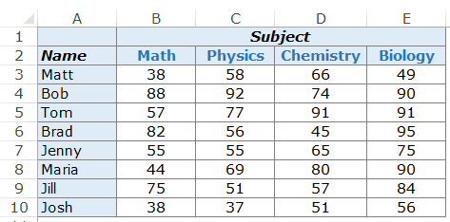
task 2
You have a list with student names in the left-most column and marks in different subjects in column B to E. You need to know how much Brad scored in Math.

Slide 14
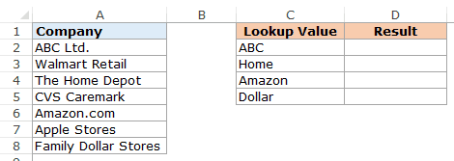
task3
You have a data set as shown below, and you want to look for the company ABC in a list, but the list has ABC Ltd instead of ABC.

Slide 15
How it works
The formula to retrieve the employee’s name uses the VLOOKUP function. VLOOKUP takes four arguments: lookup value, lookup range, column, and match. VLOOKUP searches down the first column of the lookup range until it finds the lookup value.
When the lookup value is found, VLOOKUP returns the value in the column identified by the column argument. In this case, the column argument is 2, and VLOOKUP returns the classic favorite of coffee from the second column.

Slide 16
Note
All of the VLOOKUP functions in this example have FALSE as the final argument. A FALSE in the match argument tells VLOOKUP to return a value only if it finds an exact match. If it doesn’t find an exact match, VLOOKUP returns N/A#.

Slide 17
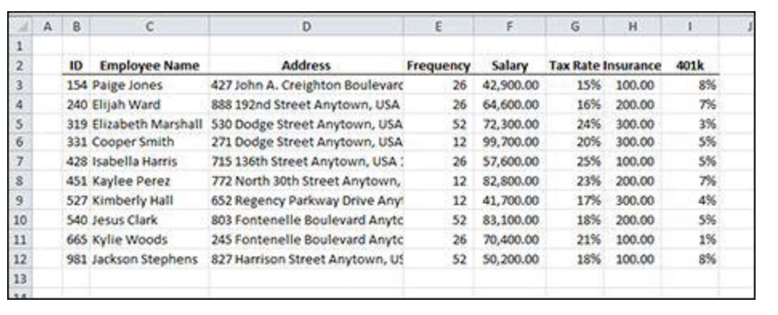
A table of employee information
Figure shows a table of employees. You want to fill out a simplified paystub
form by pulling the information from this table when an employee’s ID is selected.

Slide 18
A table of employee information
The user will select an employee ID from a data validation list in cell L3. From that piece of data, the employee’s name, address, and other information will be pulled into the form. The formulas for the paystub form in Figure are shown here:
Employee Name: =VLOOKUP($L$3,$B$3:$I$12,2,FALSE)
Pay: =VLOOKUP($L$3,$B$3:$I$12,5,FALSE)/VLOOKUP($L$3,$B$3:$I$12,4,FALSE)
Taxes: =(M7-O8-O9)*VLOOKUP($L$3,$B$3:$I$12,6,FALSE)
Insurance: =VLOOKUP($L$3,$B$3:$I$12,7,FALSE)
Retirement: =M7*VLOOKUP($L$3,$B$3:$I$12,8,FALSE)
Total: =SUM(O7:O10)
Net Pay: =M7-O11

Slide 19
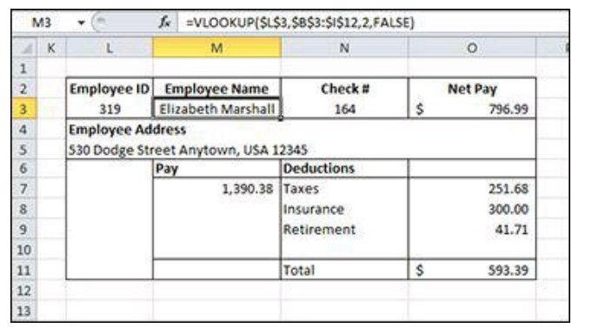
A simplified paystub form.

Slide 20
The other formulas also use VLOOKUP with a few twists. The address and insurance formulas work just like the employee name formula, but they pull from a different column. The pay formula uses two VLOOKUPs; one divided by the other.
The employee’s annual pay is pulled from the fifth column and is divided by the frequency from the fourth column, resulting in the pay for one paystub.
The retirement formula pulls the percentage from the eighth column and multiplies that by the gross pay to calculate the deduction. Finally, the taxes formula deducts both insurance and retirement from gross pay and multiplies that by the tax rate, found with VLOOKUP pulling from the sixth column.
Of course, payroll calculations are a little more complex than this, but when you understand how VLOOKUP works, you can build even more complex models.

